Slide 1

On Scheduling Constraint Abstraction for Multi-Threaded Program Verification
Liangze Yin
National University of Defense Techlonogy
November 23, 2018

Slide 2
Outline
Introduction
The SCAR Method
Experimental Results
Other Works

Slide 3
Outline
Introduction
The SCAR Method
Experimental Results
Other Works

Slide 4
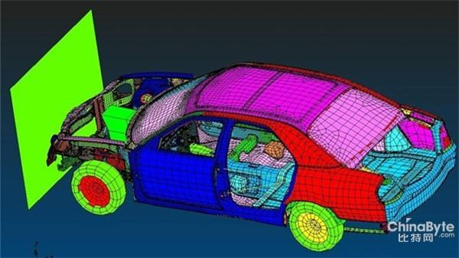

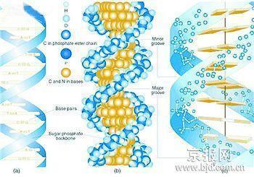

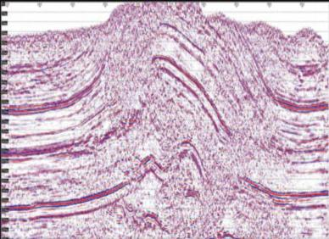

Background
Concurrent programs have been widely used
CAE simulation
Nuclear blast simulation
biology
Oil exploration
Seismic data processing
Anime

Slide 5
Background
Concurrent programs are ubiquitously available to take full advantage of the computing resources
Traditional approaches such as testing are difficult to guarantee the correctness of such programs
Formal verification is an important method to guarantee the correctness of programs
Concurrent program verification is of great significance for concurrent program application
Notes:
Facilitated by the population of multi-core architectures, concurrent programs are ubiquitously
available to take full advantage of the available computing resources. However, due to
nondeterministic interleavings among threads, traditional approaches such as testing and
simulation are difficult to guarantee the correctness of such programs

Slide 6
Existing Work
challenges
Techniques
Non-Deterministic
Interleavings
Stateless Model Checking
Bounded Model Checking
Abstraction Refinement
Path Explosion
Problem
Compositional Verification
Existing techniques are still far away from verifying real concurrent programs

Slide 7
SV-COMP
To drive the invention of new methods and tools, a Software Verification Competition (SV-COMP) is held each year since 2012.
It contains 7 categories: ReachSafety, MemSafety, ConcurrencySafety, NoOverflows, Termination, SoftwareSystems, and FalsificationOverall
Participators: more than 30 popular program verifiers from dozens of contries, including CBMC, CIVL, CPA, ESBMC, Lazy-Cseq, SMACK, etc.
The competition is devised for comparison of state-of-the-art techniques and tools

Slide 8
BMC of Concurrent Programs
Traditional BMC encodes the exact behavior of a concurrent program into a monolithic formula
The property is false iff the formula is satisfiable
The satisfiability problem is solved by a constraint solver
In SV-COMP 2017, 16 out of the 18 concurrent program verifiers adopt BMC
Problem: due to the interleaving problem, the monolithic formula of the exact behavior is usually too large for modern constraint solvers

Slide 9
Our Work
Proposed a novel SCAR method to improve the performance of concurrent program verification
Efficiency: Proposed the notion of EOG and two graph-based algorithms over EOG for CE validation and refinement generation
Soundness: Enhanced our method by two constraint-based algorithms for CE validation and refinement generation
Implemented Yogar-CBMC, which won gold medals in Concurrency Track of both SV-COMP 2017 and 2018
We focus on assertion properties of
multi-threaded programs based on Pthreads

Slide 10
Outline
Introduction
The SCAR Method
Experimental Results
Other Works

Slide 11

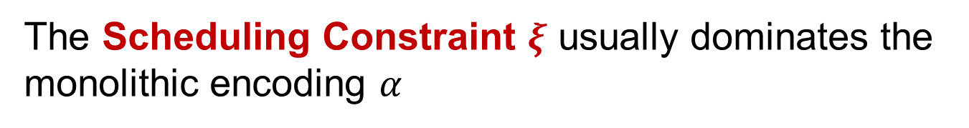
Idea of the SCAR Method
In BMC, the monolithic encoding of a concurrent program usually contains three parts
$$α≔ρ∧ς∧ξ$$
Encodes all threads individually
Encodes behavior of each shared read
Encodes the execution order requirements
The Scheduling Constraint $ξ$ usually dominates the monolithic encoding $α$

Slide 12
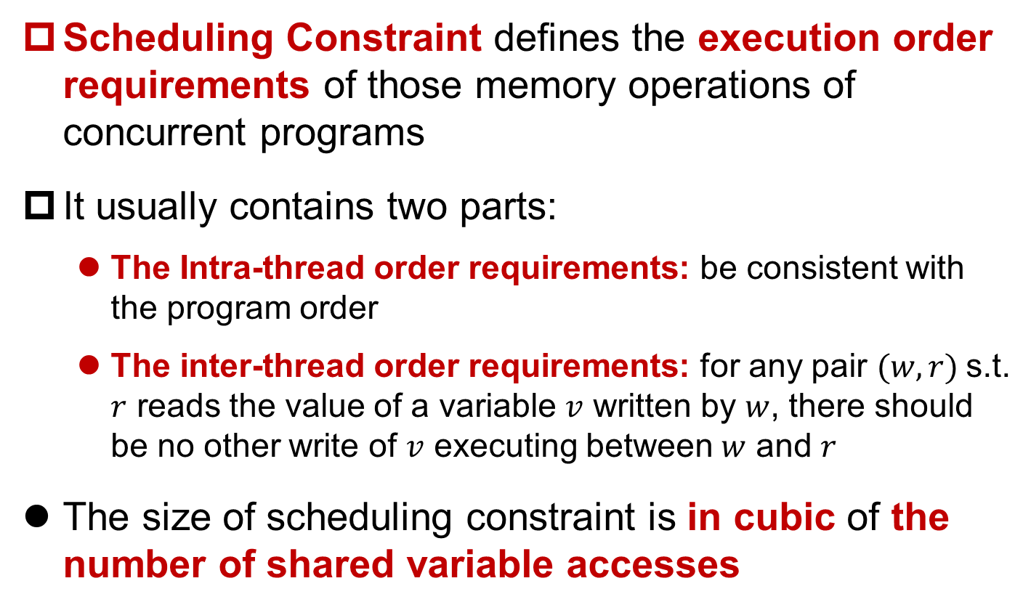
Scheduling Constraint
Scheduling Constraint defines the execution order requirements of those memory operations of concurrent programs
It usually contains two parts:
The Intra-thread order requirements: be consistent with the program order
The inter-thread order requirements: for any pair $(w, r)$s.t. $r$ reads the value of a variable $v$ written by $w$, there should be no other write of $v$ executing between $w$ and $r$
The size of scheduling constraint is in cubic of the number of shared variable accesses

Slide 13
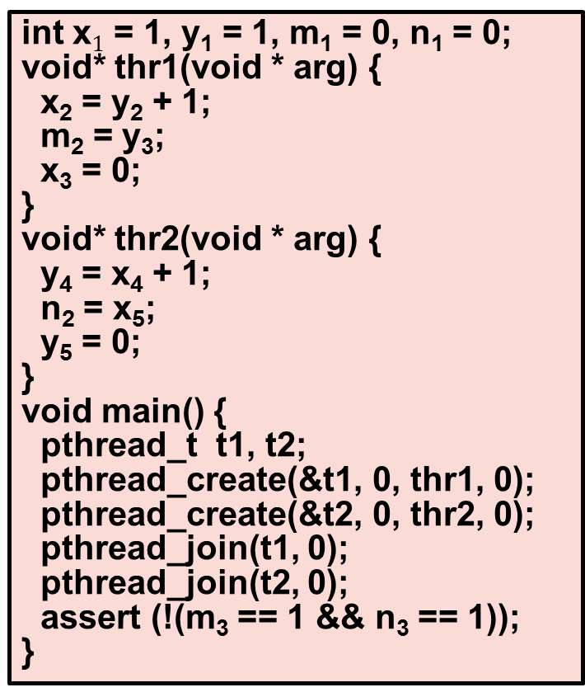
A Running Example (1)
int x = 1, y = 1, m = 0, n = 0;
void* thr1(void * arg) {
x = y + 1;
m = y;
x = 0;
}
void* thr2(void * arg) {
y = x + 1;
n = x;
y = 0;
}
void main() {
pthread_t t1, t2;
pthread_create(&t1, 0, thr1, 0);
pthread_create(&t2, 0, thr2, 0);
pthread_join(t1, 0);
pthread_join(t2, 0);
assert (!(m == 1 && n == 1));
}
int x$1$ = 1, y₁ = 1, m₁ = 0, n₁ = 0;
void* thr1(void * arg) {
x₂ = y₂ + 1;
m₂ = y₃;
x₃ = 0;
}
void* thr2(void * arg) {
y₄ = x₄ + 1;
n₂ = x₅;
y₅ = 0;
}
void main() {
pthread_t t1, t2;
pthread_create(&t1, 0, thr1, 0);
pthread_create(&t2, 0, thr2, 0);
pthread_join(t1, 0);
pthread_join(t2, 0);
assert (!(m₃ == 1 && n₃ == 1));
}
(a) The original program
(b) The SSA form of the program

Slide 14
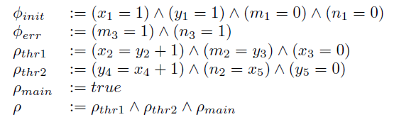
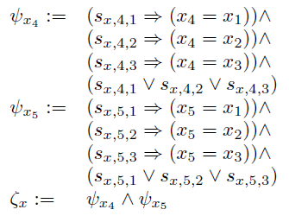
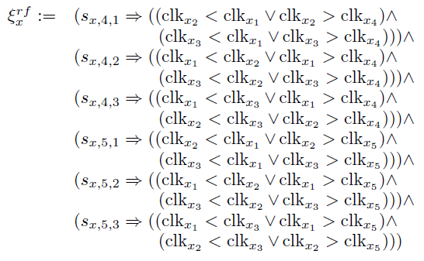
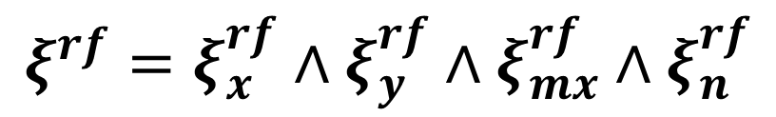
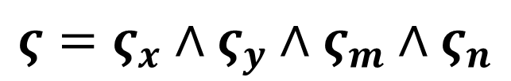

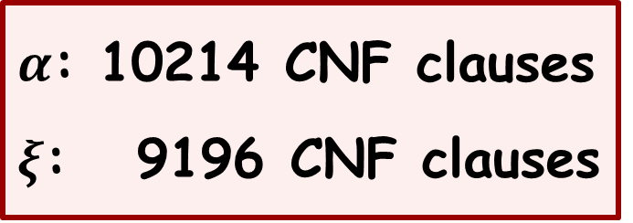
The Monolithic Encoding
$$ρ$$
$α$: 10214 CNF clauses
$ξ$: 9196 CNF clauses
$$ξ^{rf}=ξ_{x}^{rf}∧ξ_{y}^{rf}∧ξ_{mx}^{rf}∧ξ_{n}^{rf}$$
$$ς=ς_{x}∧ς_{y}∧ς_{m}∧ς_{n}$$

Slide 15

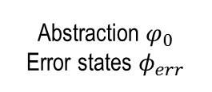


The SCAR Method
refinement
Efficiency
Soundness
Refinement Constraint
Over-approximation:
Ignore the scheduling constraint
Graph-based Refinement
Constraint-based Refinement
[Infeasible]
[Infeasible]
[Unsafe]/
Counterexample
[Not Sure]
Abstraction Model
Graph-based EOG Validation
Constraint-based EOG Validation
[Safe]
[Feasible]
Multi-Threaded C Program
validation
abstraction
Proof
True
Counterexample
To reduce the formula size, we perform abstraction refinement on the scheduling constraint

Slide 16
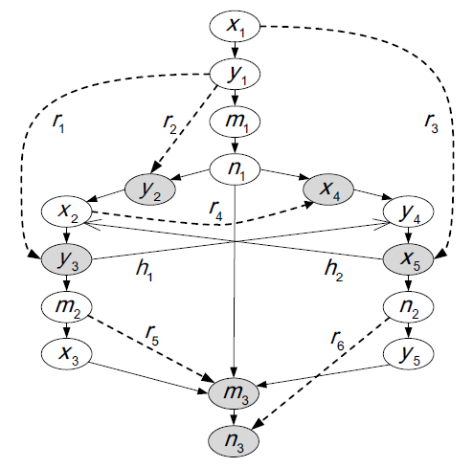
Major Innovation of SCAR
EOG (Event Order Graph) based counterexample validation and refinement generation
EOG: A graph that captures the inter-thread and intra-thread order requirements of a CE
CE Validation: Can usually hunt the infeasibility of a CE with rare exceptions
Refinement Generation: Can obtain an effective refinement constraint

Slide 17
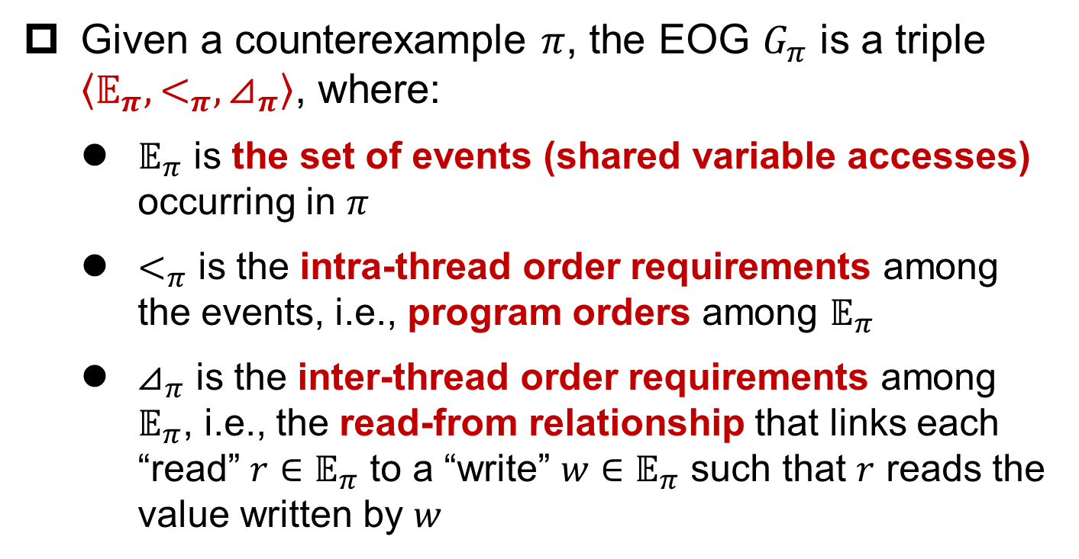
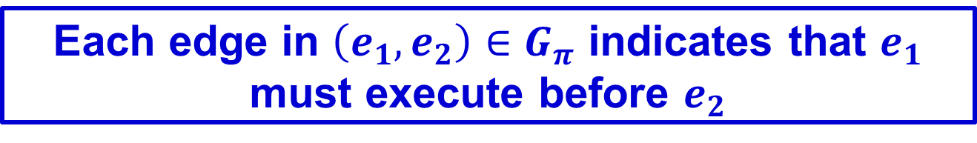
EOG Generation
Given a counterexample $π$, the EOG $G_{π}$ is a triple $\left\langle 𝔼_{π}, <_{π}, ⊿_{π}\right\rangle$, where:
$𝔼_{π}$ is the set of events (shared variable accesses) occurring in $π$
$<_{π}$ is the intra-thread order requirements among the events, i.e., program orders among $𝔼_{π}$
$⊿_{π}$ is the inter-thread order requirements among $𝔼_{π}$, i.e., the read-from relationship that links each “read” $r∈𝔼_{π}$ to a “write” $w∈𝔼_{π}$ such that $r$ reads the value written by $w$
Each edge in $\left(e_{1}, e_{2}\right)∈G_{π}$ indicates that $e_{1}$ must execute before $e_{2}$

Slide 18
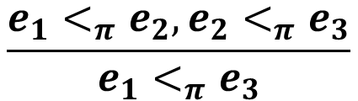
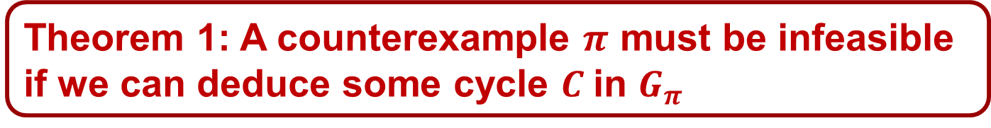
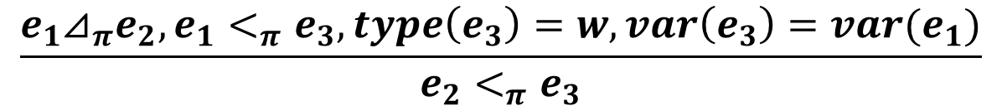
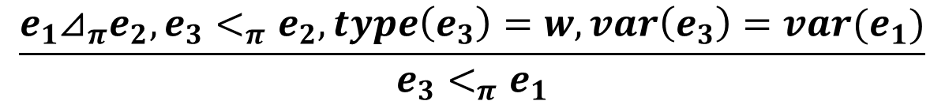
Counterexample Validation
Theorem 1: A counterexample $π$ must be infeasible if we can deduce some cycle $C$in $G_{π}$
First deduce as many possible order requirements as possible. Rules for this include:
$$\frac{e_{1}<_{π}e_{2},e_{2}<_{π}e_{3}}{e_{1}<_{π}e_{3}}$$
In practice, this method can usually hunt the infeasibility of a counterexample with rare exceptions
Rule 1.
Rule 2.
$$\frac{e_{1}⊿_{π}e_{2},e_{3}<_{π}e_{2}, type\left(e_{3}\right)=w, var\left(e_{3}\right)=var(e_{1})}{e_{3}<_{π}e_{1}}$$
Rule 3.
$$\frac{e_{1}⊿_{π}e_{2},e_{1}<_{π}e_{3}, type\left(e_{3}\right)=w, var\left(e_{3}\right)=var(e_{1})}{e_{2}<_{π}e_{3}}$$
Then check if there exists some cycle in the new $G_{π}$

Slide 19
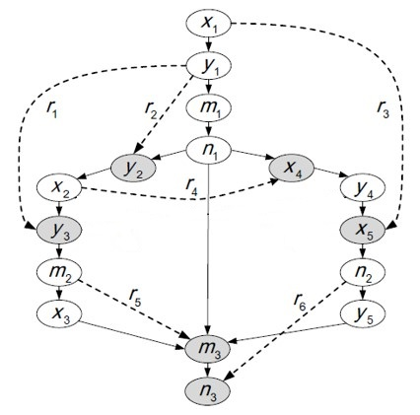
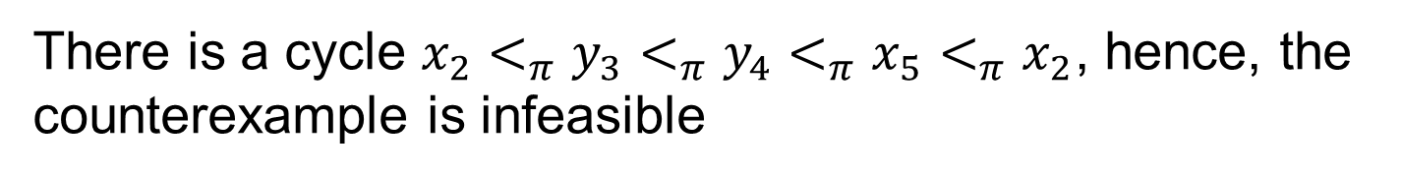
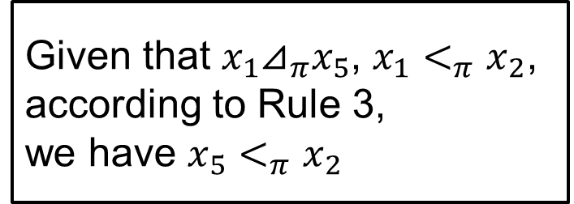

Counterexample Validation
Given that $y_{1}⊿_{π}y_{3}$, $y_{1}<_{π}y_{4}$, according to Rule 3,
we have $y_{3}<_{π}y_{4}$
Given that $x_{1}⊿_{π}x_{5}$, $x_{1}<_{π}x_{2}$, according to Rule 3,
we have $x_{5}<_{π}x_{2}$
There is a cycle $x_{2}<_{π}y_{3}<_{π}y_{4}<_{π}x_{5}<_{π}x_{2}$, hence, the counterexample is infeasible

Slide 20
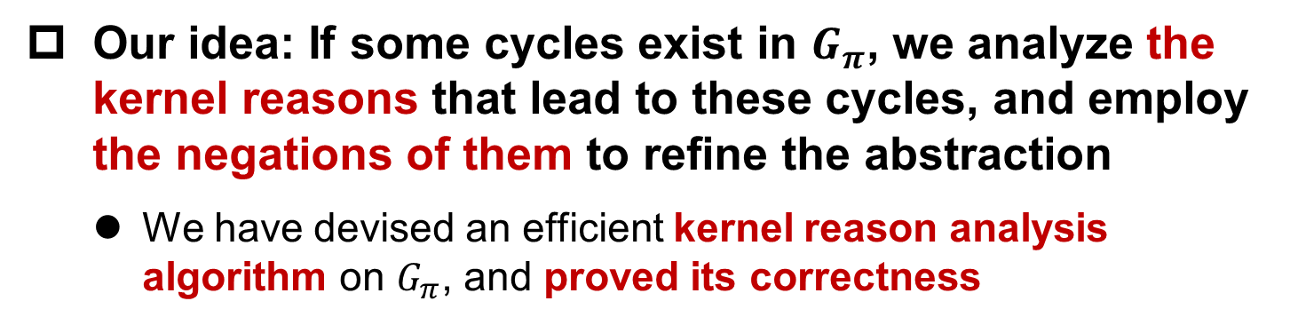
Refinement Generation
Our idea: If some cycles exist in $G_{π}$, we analyze the kernel reasons that lead to these cycles, and employ the negations of them to refine the abstraction
We have devised an efficient kernel reason analysis algorithm on $G_{π}$, and proved its correctness
Advantages of our method
Can detect all kernel reasons, leading to a large amount of search space pruned in each iteration
Maintains just the minimal subset of core kernel reasons, making the refinement small and manageable
Our algorithm can obtain effective yet small refinements

Slide 21
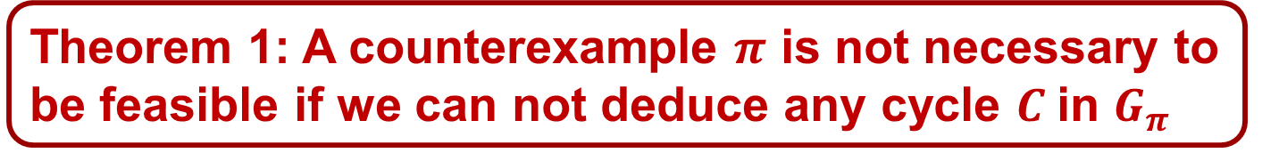
Soundness and Completeness
Theorem 1: A counterexample $π$ is not necessary to be feasible if we can not deduce any cycle $C$in $G_{π}$
We employ a constraint solving method to further determine feasibility of the EOG
CE Validation: exactly encode all order requirements into a constraint. The EOG is feasible iff the constraint is SAT
Refinement Generation: if the constraint is UNSAT, we employ the unsatisfiable core to generate the refinement
This method obtains only one kernel reason in each iteration
However, it is both sound and complete
We obtain a both efficient and sound method by combining the graph- and constraint-based methods

Slide 22
The SCAR Method
refinement
Efficiency
Soundness
Refinement Constraint
Over-approximation:
Ignore the scheduling constraint
Graph-based Refinement
Constraint-based Refinement
[Infeasible]
[Infeasible]
[Unsafe]/
Counterexample
[Not Sure]
Abstraction Model
Graph-based EOG Validation
Constraint-based EOG Validation
[Safe]
[Feasible]
Multi-Threaded C Program
validation
abstraction
Proof
True
Counterexample

Slide 23
A Running Example (2)
The monolithic encoding: 10214 CNF clauses
The initial abstraction: 1018 CNF clauses
Number of iterations required: 3
Number of increased clauses during the refinement generation: 7 CNF clauses, where each one has only two literals
10214
clauses
1018
clauses
+
1020
clauses
+
1022
clauses
+
1025
clauses
Incremental solving

Slide 24
Outline
Introduction
The SCAR Method
Experimental Results
Other Works

Slide 25
Experimental Results
Our tool is named Yogar-CBMC
It won the gold medal in SV-COMP 2017, 2018
Compared with the silver medal tool:
5.8x faster
consumes only 39% of the memory
The benchmark includes 1047 concurrent C programs based on Pthread
The participartors cover 18 popular verifiers suppor-ting concurrent C programs

Slide 26

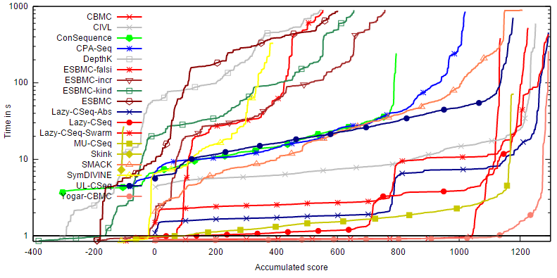
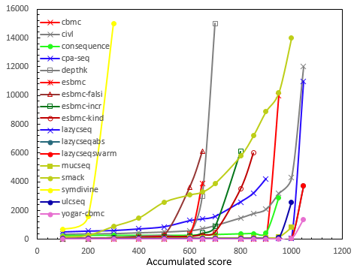
Experimental Results
SV-COMP 2017
Yogar-CBMC
Time
Memory
https://sv-comp.sosy-lab.org/2017/results/results-verified/

Slide 27
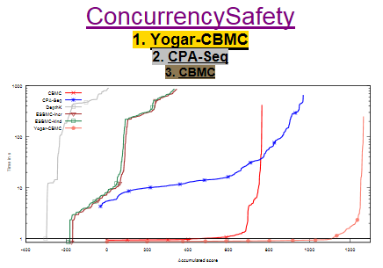
Experimental Results
SV-COMP 2018
Yogar-CBMC
时间
https://sv-comp.sosy-lab.org/2018/results/results-verified/

Slide 28
Outline
Introduction
The SCAR Method
Experimental Results
Other Works

Slide 29
Other Works
Parallelized SCAR by parallel refinement to further improve the verification performance
Extend SCAR from Sequential Consistency to Weak Memory Models such as TSO and PSO
Apply our method to other concurrent languages such as OpenMP

Slide 30
Thanks
Q&A

